Slide 1
2025 Hydropower Collegiate Competition (HCC)
Noah Dilworth
Jennifer Edgar
Robert Ginieczki
Benjamin Tushingham

Slide 2
Project Description
Problem Statement: With the desire to remove US reliance on coal, nuclear, and fossil fuel driven energy while also taking advantage of potential energy in respect of water batteries through a closed-loop pumped storage hydropower system. This model will help to address the nations clean energy goals while preserving the environment and making use of untapped power.
Sponsor: US Department of Energy + Energy Club
Advisor/Client: Dr. Carson Pete
Fig. 1: Art for HCC Competition
Robert Ginieczki

Slide 3
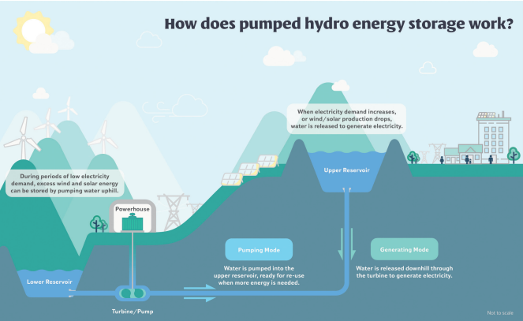
Background & Benchmarking
Oriville Thermatillo Complex
Thorovilel damn and Thermatillo Pump complex
Four Turbines creating 118MW of electricity, powering over 100,000 homes
Horse Mesa Dam
Pumped Storgage Hydro added in 1972
Power output of 97 MW
Local, allowing the team to visit the site and understand more about the system
Helms Pumped Storage Project
Under the process of getting renovated, receving comments on the plans on the 30th of August
Max Work production of 1080 MW
3 reversible turbines
Due to a fire in 2012, upgraded eletrical systems and safety measures
Fig. 2: Simple overview of Pumped Storage Hydro
Ben Tushingham

Slide 4
Customer and Engineering Requirements
Customer Requirements
Energy Production
Engineering Requirements
Max/Min Energy Output (MW)
Minimal Environmental Impact
Pumped Storage Hydropower Site Feasibility
Community Engagement
Scalability
Reasonable Cost
Environmental Impact (%)
Efficiency (MWh)
Social/Community Impact (#)
Feasibility (years)
Site Interconnectivity ($)
Robert Ginieczki

Slide 5
House of Quality (QFD)
 | 1 | Energy Output
 | 2 | Environmental | 1
 | 3 | Efficiency | 9 | 1
 | 4 | Social/ community | 1 | 3 | 3 |  |  |  | A | The Helms Pumped Storage Project [1]
 | 5 | Competitiveness | 9 | 1 | 9 | 3 |  |  | B | SRP (Horse Mesa Dam) [2]
 | 6 | Site location | 3 | 9 | 3 | 3 | 3 |  | C | Oroville Dam [3]
 | Technical Requirements |  |  |  |  |  |  |  | Comparable Product Comparison
Production Req. | weights | %weight | energy output | environmental | efficiency | social/ community | competitiveness | site location | 1 (Poor) | 2 | 3 (Acceptable) | 4 | 5 (Excellent)
energy production | 5 | 0.25 | 9 | 3 | 9 | 7 | 9 | 7 |  | A | B |  | C
environmental impact | 5 | 0.25 | 3 | 9 | 3 | 5 | 7 | 7 |  |  | A | BC
cost | 4 | 0.2 | 7 | 7 | 7 | 5 | 9 | 5 |  |  | AC | B
community interactivity | 3 | 0.15 | 3 | 7 | 5 | 9 | 5 | 5 |  | A |  | B | C
scale/ longevity | 3 | 0.15 | 9 | 9 | 5 | 5 | 9 | 5 |  | A |  | B | C
 |  | units | GW (10^6 W) | N/A | GW/GW | N/A | N/A | Miles
 |  | weighted score | 6.2 | 6.8 | 5.9 | 6.1 | 7.9 | 6
 |  | rank | 3rd | 2nd | 6th | 4th | 1st | 5th
More weight on energy & environmental
No comparable sources was closed loop
Site location by distance to major power consumers
Fig. 3: QFD
Noah Dilworth

Slide 6
Literature Review
Books
Fluid Mechanics Ninth Edition Chapter 11 [4]
Serves as a reference textbook for turbine efficiency equations and examples
Power Generation Technologies Chapter 8 – Hydropower [5]
Section about 3 specific turbines and their advantages and disadvantages in hydropower
Papers
Trends and Challenges in the Operation of Pumped-Storage Hydropower Plants [6]
Discusses the pros of hydropower in a storage aspect to wind and solar and the challenges that follow them along with some challenges related to the electrical side of the storage.
Life Cycle Assessment of Closed-Loop Pumped Storage Hydropower in the United States [7]
This paper looks at the environmental aspects of the systems and gives equations to calculate it's effect of the surrounding area. This will be helpful in considering what system will preserve the environment the most.
Experimental and Numerical Studies of a High-Head Francis Turbine: A Review of the Francis-99 Test Case [8]
One of the favored turbines in hydropower is the francis turbine and this paper breakdown a real-life study done to test multiple aspects of the turbine. If we decide to use the Francis turbine the equations and description for how to understand the Francis turbine is very beneficial.
Other
Hydropower – Engineering Toolbox [9]
Covers equations for calculating the theoretical and actual power of a turbine. Used these equations for mathmatical modeling calculations.
Types of Hydropower Turbines [10]
The department of energy's website stating and describing the different turbine options in hydropower.
ASME : PTC 18
Covers performance testing and measurement guidelines to provide information of hydropower systems. I am still currently working on getting full access to this standard.
Jennifer Edgar

Slide 7
Literature Review
Books
Pumped Hydro Energy Storage for Hybrid Systems: Chapter 2 – Need for pumped hydro energy storage systems [12]
Benefits of pumped storage-hydro and grid stabilization with emphasis on frequency and voltage regulation. The chapter also highlights some of the different pumped storage-hydro hybrid designs.
Final Environmental Impact Statement For Hydropower License: Swan Lake North Pumped Storage Project [13]
Real and comparable environmental impacts of local ecosystems that involve permanent land losses, soil erosion, recreational land usage loss, water loss due to evaporation and counters to water loss, and possible visual ailments involving construction.
Papers
Francis Turbines: Harnessing the Power of Water [14]
This paper breaks down the characteristics of Francis turbines including their application ranges with direct output in relations to head size in meters. Standard production Francis turbines to custom made turbines are covered.
Measurement: Increasing the operating range and energy production in Francis turbines by an early detection of the overload instability [15]
The theoretical implementation of known data and A.I. to support increasing power output of Francis turbines with causing catastrophic instability within the turbine.
Promoting Closed-Loop Storage Hydropower Act [16]
Act that would speed up approval process of pumped storage hydropower systems to 2-years rather than 10-year approval periods.
Other
Design Features of the Helms Pumped Storage Project: Pg. 10-12 [17]
Indepth breakdown of electrical systems implemented into a similar, but not completed the same, pumped storage hydropower system.
Energy: A GIS-based model to calculate the potential for transforming conventional hydropower schemes and non-hydro reservoirs to pumped hydropower schemes [18]
Identifying possible locations that are suitable for pumped storage hydropower systems. 400 sites with 3800 GWh potential energy storage. Similar search relevant to US search.
Robert Ginieczki

Slide 8
Literature Review
Books
Fluid Mechanics Ninth Edition – Chapter 4 and 5 [4]
Velocity in a pipe and the velocity coming from the pressure of the reservoir
Soil Mechanics and Foundations – chapter 32 and more [20]
Looking into what materials are in reservoir and properties to look out for
Papers
Closed-Loop Pumped Storage Hydropower Resource Assessment for the United States [21]
Shows site selection and cost of project relative to energy produced
Renewable Energy Technologies: Cost Analysis Series – Hydropower [22]
Provides cost and performance data of hydropower energy production
Swan Lake Final Environmental Impact Statement For Hydropower License [23]
Goes over Environmental challenges for a Closed Loop PSH system, allows us to Figure out what is needed for our project to viable to be an actual system
Standard
FERC Engineering Guidelines for the Evaluation of Hydropower Projects [24]
Goes over FERC standards for Hydro systems to be implemented and approved
Other
Bath County Pumped Storage Website [25]
Largest PSH in the United States. Good reference point to look at and can contact the company later to seek guidance
Ben Tushingham

Slide 9
Literature Review
Books
Material Sciences and Engineering 10th edition – Chapters 16, 17, & 19 [26]
Material selection, with formulas for calculating mechanical, thermal, and electrical properties
Shigley's Mechanical Engineering Design 11th edition – Parts 2 & 3 [27]
Stress and failure calculations
Papers
Abrasion erosion of concrete by water-borne sand [28]
A metric for wear depending on how clean our water is for the project
A novel reliability-based method of calibrating safety factor: Application to the cemented sand and gravel dams [29]
Calculations for concrete under stress
Concrete Dams: thermal-stress and construction stage analysis [30]
About planning the construction of our theoretical closed loop hydropower energy storage structure
Other
Failure Modes Approach to Safety Evaluation of Dams [31]
Frequent and compounding sources of structural damage and failure in hydropower structure
Dam Safety and Dam Hazards [32]
Discusses safety considerations in regards to failure but also impact on communities
Noah Dilworth

Slide 10
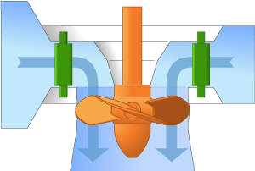
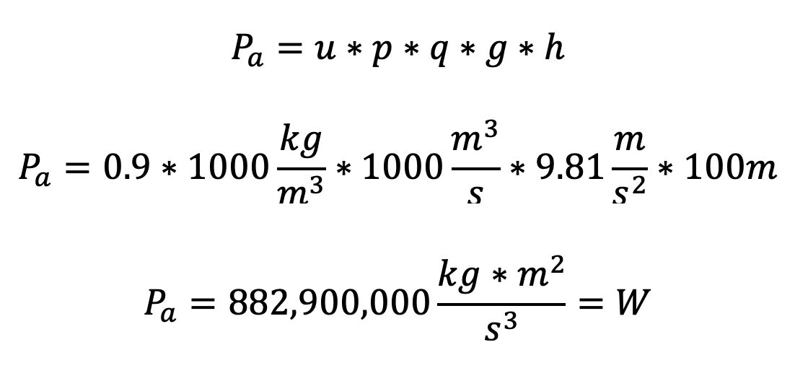
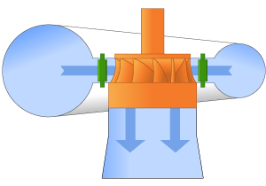
Mathematical Modeling
Engineering Toolbox [9]
Efficiency (u) general range 0.75 to 0.95
Efficiency Ranges [5]
Practically Available Power: P_{a} (W)
Kaplan Turbine ~ 90% efficiency
Fig. 4: Keplan Turbine [10]
Pelton Turbine ~ 90-95%%
Fig. 5: Pelton Turbine [10]
Francis Turbine ~ 90-95%
Fig. 6: Francis Turbine [10]
Jennifer Edgar

Slide 11
Mathematical Modeling
Volume needed will change drastically based off different variables
Electrical needs of nearby city
Change in head of the two reservoirs
Number of Turbines used.
This number is based off competition Power needs, not electrical needs
Enviromental concerns due to change in conditions
Amount of water needed to keep Reservoir Structurally safe
Absolute minimum water needed
Assuming Head is roughly 200m
Flow Rate is 500m^3/s for 2 turbines
1 turbine is needed outside of peak energy time for city needs
Peak is needed for 4 hours/ non-peak for 20 hours
Minimum Volume
1000(m^3/s)*(60s/m)*(60m/h)*(4h)= 1.44 Million Cubic Meters
500(m^3/s)*(60s/m)*(60m/h)*(20h)= 3.6 Million Cubic Meters
Total volume = 5.04 Million cubic meters
Fig. 7: Volume from Volumetric Flow Rate
Ben Tushingham

Slide 12
Mathematical Modeling
Tunneling Cost Equation:
Power Output in Relation to RPM:
P(W) = τ*RPM*(2*π)/60
1,000,000,000 = τ*(850RPM)*(2*π)/60
Our theoretical torque = 11.6 Million Nm of force
Τ = Torque in Newton-Meters
Fig. 8: Tunnelling cost equation according to NREL [21]
Conversions (GW to MW to W)
GW- 1:1,000 MW
MW- 1:1,000,000 W
W- 1,000,000,000
Based off a Reservoir size of 5.04 million Cubic Meters:
Eg = 86.92
h = 200m
l = 1000m
Inputting this data into equation:
Ct = $41,066,155.47
Robert Ginieczki

Slide 13
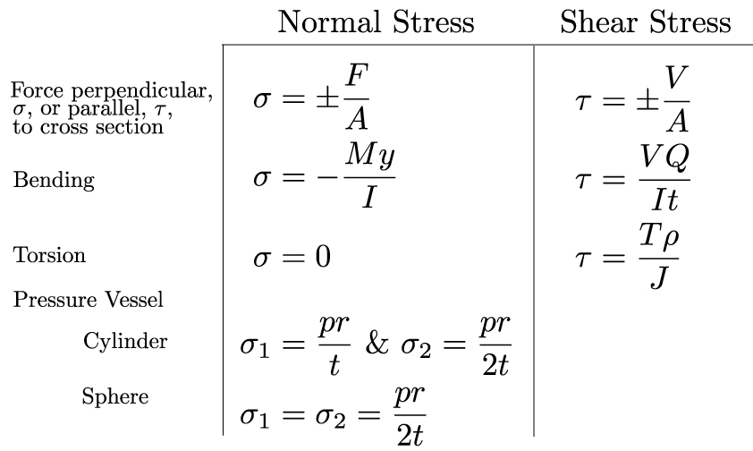
Mathematical Modeling
Material Stress Calculations
Calculating the stresses in our simple parts, combining loads to compare with material properties
Normal and Shear vary
Used for calculating safety factors and such
Fig. 9: Material Stress Calculations [33]
Noah Dilworth

Slide 14
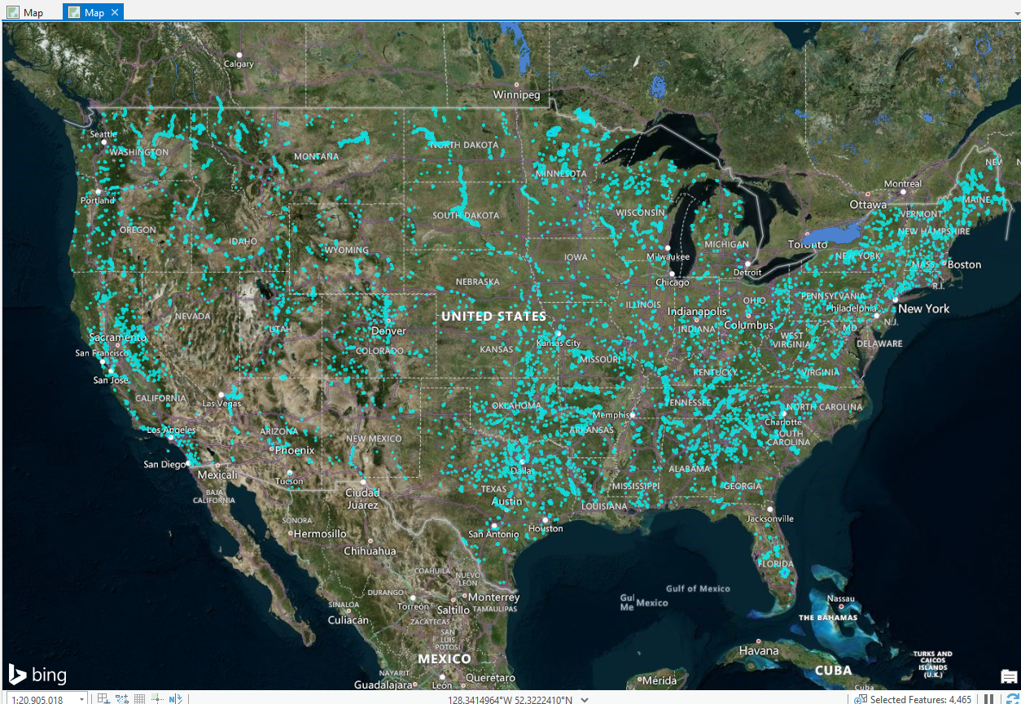
Mathematical Modeling
Using ARCgis from Esri to pull data from various topics to help site selection
Attributes for the dam selection in the site can include:
Average Rain Fall
Elevation Differences
Power Lines
Existing Reservoirs/Rivers
Fig. 10: ARCgis Map showing Reservoirs in the United States
Ben Tushingham

Slide 15
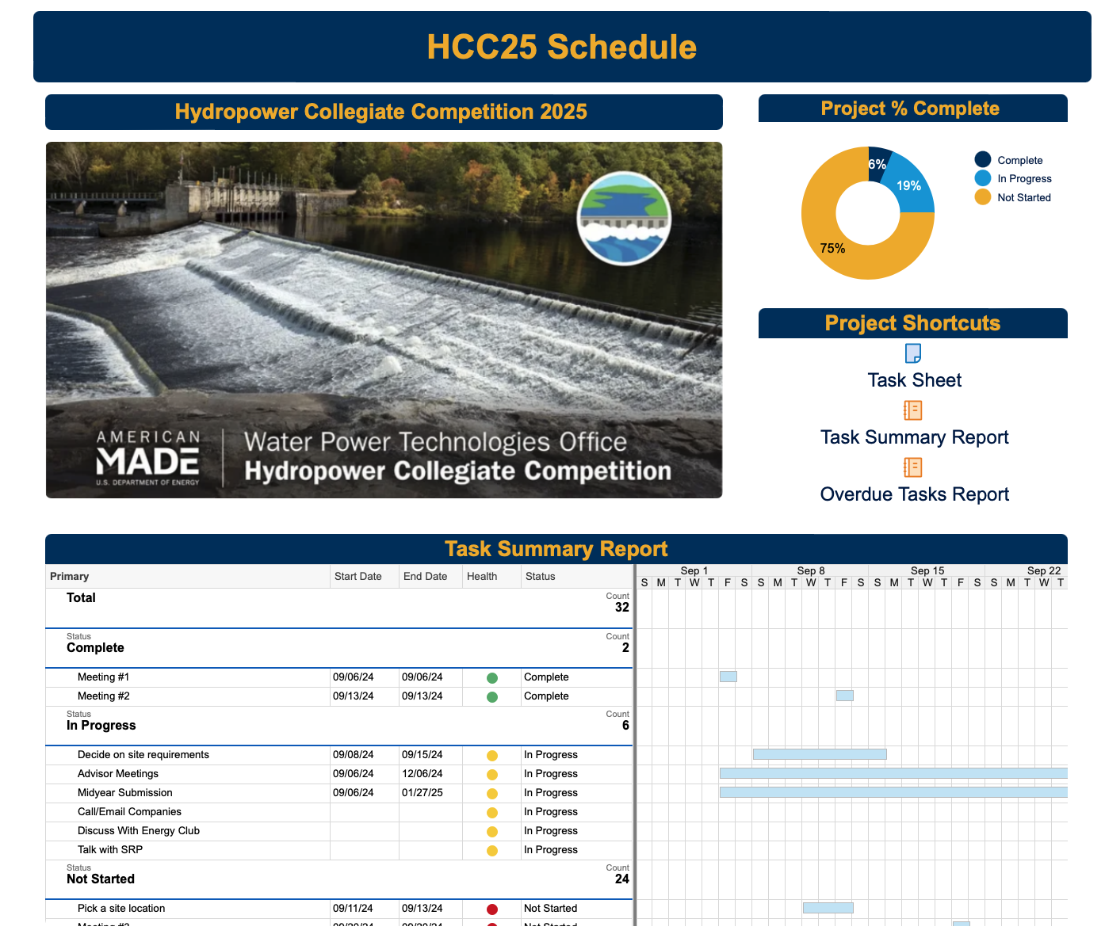
Schedule and Budget
Key Dates:
HCC Kickoff Meeting: October 4th
Midyear Submission: January 27, 2025, at 11:59 p.m. MST
Budget: $15,000
Additional $1,500 that the team is going to fundraise
Joining the Energy club to set up fundraising opportunities for the energy capstones
Jennifer Edgar

Slide 16
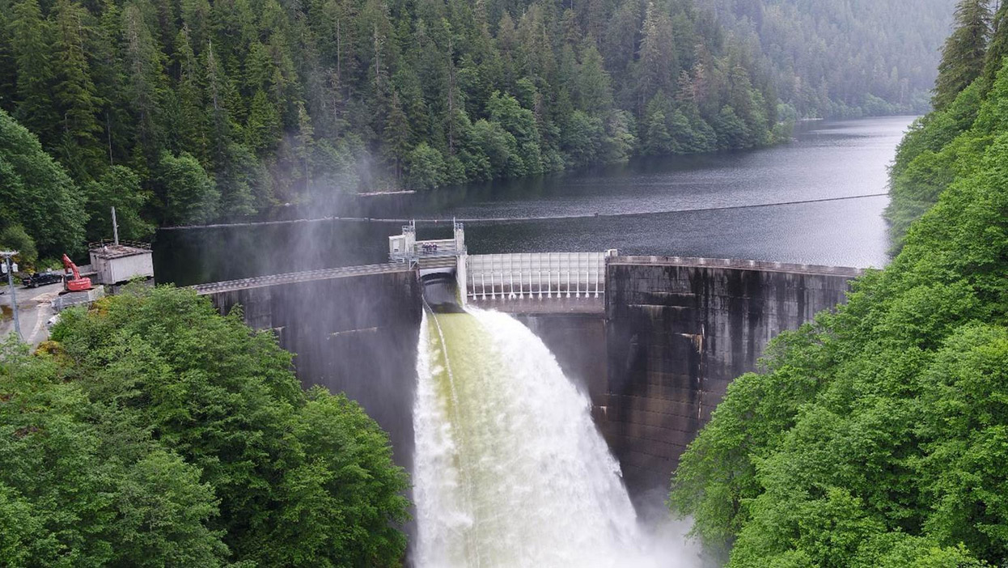
Conclusion
Overall: Project requirements identified, and team is familiar with technology
Prepare for HCC Kickoff Meeting with questions and background knowledge
Obtain more resources and project personnel to begin site selection
Next Steps: Contact potential funding sources
Jennifer Edgar

Slide 17
Thank You!

Slide 18
References
[1] K. Paul Jr. "Design Features of the Helms Pumped Storage Project", IEEE Transactions of Energy Conversion, vol. 4, no. 1. March 1989.
[2] "SRP Power Generation Sources", SRP website, accessed Sept. 15, 2024. [Online]. Avaliable: https://www.srpnet.com/grid-water-management/grid-management/power-generation-stations.
[3] "Oroville", California Department of Water Resources, accessed Sept. 15, 2024. [Online]. Avaliable: https://water.ca.gov/programs/state-water-project/swp-facilities/oroville#:~:text=It%20also%20provides%20pumped%2Dstorage,feet%2C%20in%20the%20United%20States.
[4] F. M. White and H. Xue, Fluid Mechanics. New York, NY: McGraw-Hill, 2021.
[5] P. Breeze, “Chapter 8 - Hydropower,” in Power Generation Technologies (Second Edition) , Newnes, 2014, pp. 153–179
[6] J. I. Pérez-Díaz, M. Chazarra, J. García-González, G. Cavazzini, and A. Stoppato, “Trends and challenges in the operation of pumped-storage hydropower plants,” Renewable and Sustainable Energy Reviews, vol. 44, pp. 767–784, Apr. 2015. doi:10.1016/j.rser.2015.01.029
[7] T. R. Simon et al., “Life cycle assessment of closed-loop pumped storage hydropower in the United States,” Environmental Science &amp; Technology, vol. 57, no. 33, pp. 12251–12258, Aug. 2023. doi:10.1021/acs.est.2c09189
[8] C. Trivedi, M. Cervantes, and O. Dahlhaug, “Experimental and numerical studies of a high-head Francis Turbine: A review of the Francis-99 Test Case,” Energies, vol. 9, no. 2, p. 74, Jan. 2016. doi:10.3390/en9020074
[9] E. Engineeringtoolbox, “Hydropower,” Engineering ToolBox, https://www.engineeringtoolbox.com/hydropower-d_1359.html (accessed Sep. 14, 2024).
[10] “Types of hydropower turbines | Department of Energy,” Department of Energy, https://www.energy.gov/eere/water/types-hydropower-turbines (accessed Sep. 15, 2024).
[11] “Francis Turbine: Diagram, construction, working, applications,” Testbook, https://testbook.com/mechanical-engineering/francis-turbine (accessed Sep. 14, 2024).
[12] F. A. Diawuo and R. T. Amanor, "Need for pumped hydro energy storage systems," in Pumped Hydro Energy Storage for Hybrid Systems, A. T. Kabo-Bah, F. A. Diawuo, and E. O. Antwi, Eds. Academic Press, 2023, pp. 23-41. doi: 10.1016/B978-0-12-818853-8.00001-7

Slide 19
References
[13] Federal Energy Regulatory Commission, "Final Environmental Impact Statement for the Mountain Valley Pipeline Project," Federal Energy Regulatory Commission, Jan. 25, 2019. [Online]. Available: https://www.ferc.gov/sites/default/files/2020-06/01-25-19-FEIS.pdf. [Accessed: Sep. 16, 2024].
[14] Voith, "Francis Turbines," Voith, 2018. [Online]. Available: https://voith.com/corp-en/VH_Product-Brochure-Francis-Turbines_18_BDI_VH3369_en.pdf. [Accessed: Sep. 16, 2024].
[15] W. Zhao, A. Presas, M. Egusquiza, D. Valentín, E. Egusquiza, and C. Valero, "Increasing the operating range and energy production in Francis turbines by an early detection of the overload instability," Measurement, vol. 181, p. 109580, 2021. doi: 10.1016/j.measurement.2021.109580.
[16] U.S. House of Representatives, "Report on the Activities of the Committee on Energy and Commerce for the One Hundred Fifteenth Congress," U.S. Government Publishing Office, Washington, DC, Rep. 115-458, 2018. [Online]. Available: https://www.govinfo.gov/content/pkg/CRPT-115hrpt458/pdf/CRPT-115hrpt458.pdf. [Accessed: Sep. 16, 2024].
[17] "Design features of the Helms pumped storage project," IEEE Xplore, pp. 10-12. [Online]. Available: https://www.ieee.org. [Accessed: Sep. 16, 2024].
[18] N. Fitzgerald, R. Lacal Arántegui, E. McKeogh, and P. Leahy, "A GIS-based model to calculate the potential for transforming conventional hydropower schemes and non-hydro reservoirs to pumped hydropower schemes," Energy, vol. 41, no. 1, pp. 483-490, 2012. doi: 10.1016/j.energy.2012.02.044. [Accessed: Sep. 16, 2024].
[19] F. M. White and H. Xue, Fluid Mechanics. New York, NY: McGraw-Hill, 2021.
[20] B. C. Punmia, Ashok Kumar Jain, and Arun Kumar Jain, Soil mechanics and foundations. Delhi: Laxmi Publications (P) Ltd., , C, 2005.
‌[21] “Closed-Loop Pumped Storage Hydropower Resource Assessment for the United States Final Report on HydroWIRES Project D1: Improving Hydropower and PSH Representations in Capacity Expansion Models,” 2022. Available: https://www.nrel.gov/docs/fy22osti/81277.pdf
[22]"2021 Pumped Storage Hydro Report," 2021. Available: 2021-Pumped-Storage-Report-NHA.pdf (hydro.org)

Slide 20
References
[23] S. Lake, “FINAL ENVIRONMENTAL IMPACT STATEMENT FOR HYDROPOWER LICENSE,” 2019. Accessed: Sep. 17, 2024. [Online]. Available: https://www.ferc.gov/sites/default/files/2020-06/01-25-19-FEIS.pdf
[24] “Federal Energy Regulatory Commission Engineering Guidelines for the Evaluation of Hydropower Projects,” 2017. Accessed: Sep. 17, 2024. [Online]. Available: https://www.ferc.gov/sites/default/files/2020-04/Chap14AppendixH.pdf
‌[25] “Bath County Pumped Storage Station | Dominion Energy,” www.dominionenergy.com. https://www.dominionenergy.com/projects-and-facilities/hydroelectric-power-facilities-and-projects/bath-county-pumped-storage-station
[26] W. D. Caster Jr., D. G. Rethwisch. "Material Sciences and Engineering". Danvers, MA: McGraw-Hill Education, 2000. ISBN-13: 9781119321590
[27] R. G. Budynas, J. K, Nisbett. "Shigley's Mechanical Engineering Design". New York, NY: John Wiley and Sons, Inc., 2020. ISBN-978-0-07-339821-1
[28] Y. Liu, T. Yen, T Hsu. "Abrasion erosion of concrete by water-borne sand". Cement and Concrete Research, vol. 36, issue 10,
2006, pages 1814-1820, ISSN 0008-8846, https://doi.org/10.1016/j.cemconres.2005.03.018.
[29] N. Hao, X. Li, Y. Li, J. Jia, L. Gao. "A novel reliability-based method of calibrating safety factor: Application to the cemented sand and gravel dams". Engineering Geology, vol. 306, 2022, ISSN 0013-7952, https://doi.org/10.1016/j.enggeo.2022.106719.
[30] E. Sayed-Ahmed, A. Abdelrahman, R. Embaby. "Concrete dams: thermal-stress and construction stage analysis". Dams and Reservoirs, vol. 28 issue 1, pp. 12-30. March, 2018. E-ISSN 1756-8404. [Online]. Accessed September 15, 2024. Avaliable: https://doi.org/10.1680/jdare.16.00055
[31] Y. Ghanaat. "Failure Modes Approach to Safety Evaluation of Dams". 13th World Conference on Earthquake Engineering, Vancouver, CA, paper no. 1115. Accessed Sept. 15, 2024. [Online]. Avaliable: http://queststructures.com/publications/13WCEE-Paper.pdf
[32] J. Laue, and S. Knutsson, ‘Dam Safety and Dams Hazards’, Journal of Earth Sciences and Geotechnical Engineering,, vol. 10, no. 6, pp. 23–40, 2020.

Slide 21
References
[33] D. Holmes. "Mechanics of Materials: Combined Loading". Boston University Mechanical Engineering. Accessed Sept. 15, 2024. Avaliable:https://www.bu.edu/moss/mechanics-of-materials-combined-loading/
[34] masao, “PPT - Fluid Systems PowerPoint Presentation, free download - ID:2402299,” SlideServe, Jul. 26, 2014. https://www.slideserve.com/masao/fluid-systems (accessed Sep. 17, 2024).
[35] Hydraulic Turbines and Pump-Turbines: PTC 18 - 2020(R2016). New York, NY: American Society of Mechanical Engineers, 2021

